Slide 1
International Baccalaureate Diploma Programme
A challenging curriculum for the 21st Century.

Slide 2
Weber High School is a candidate school* for the Diploma Program. This means we are pursuing authorization as an IB World School. These are schools that share a common philosophy—a commitment to high quality, challenging, international education that Weber High School believes is important for our students.
Last year there were 86 schools who became authorized IB Diploma program schools.
25 schools were authorized in Asia
38 schools were authorized in Europe
23 schools were authorized in the Americas
13 schools were from the United States

Slide 3
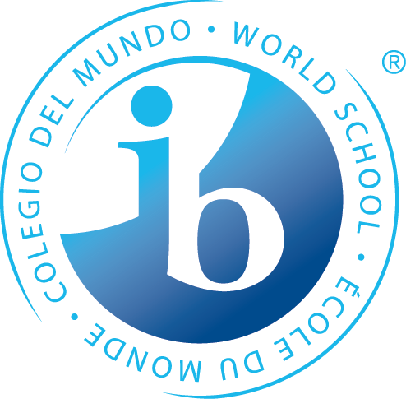
What is IB?
Founded in 1968, the International Baccalaureate® (IB) is a non-profit educational foundation offering four highly respected programs of international education that develop the intellectual, personal, emotional and social skills needed to live, learn and work in a rapidly globalizing world.
Specifically, the Diploma Program is a rigorous, interdisciplinary, international college preparatory program

Slide 4
Mission statement
The International Baccalaureate® aims to develop inquiring, knowledgeable and caring young people who help to create a better and more peaceful world through intercultural understanding and respect.
To this end the organization works with schools, governments and international organizations to develop challenging programs of international education and rigorous assessment.
These programs encourage students across the world to become active, compassionate and lifelong learners who understand that other people, with their differences, can also be right.

Slide 5
The IB Learner Profile
The aim of all IB programmes is to develop internationally minded people who, recognizing their common humanity and shared guardianship of the planet, help to create a better and more peaceful world.
IB Learners strive to be:
Inquirers
Knowledgeable
Thinkers
Communicators
Principled
Open-minded
Caring
Risk-takers
Balanced
Reflective

Slide 6
Benefits of IB
IB Students generally will…
be encouraged to think independently and drive their own learning
take part in programs of education that can lead them to some of the highest ranking universities around the world
become more culturally aware, through the development of a second language
be able to engage with people in an increasingly globalized, rapidly changing world
earn up to 30 college credits upon earning an IB Diploma

Slide 7
Benefits of IB

Slide 8
Benefits of IB – student quotes

Slide 9
Benefits of IB
University Graduation Rates
The average four-year graduation rate of all DP students (both diploma earners and non-earners) was 79% compared to 39% of all students.

Slide 10
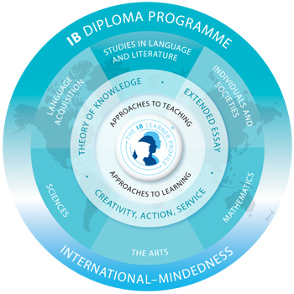
IB Coursework
IB organizes teaching and learning through 6 subject groups creating the wheel
Students must choose a course of study from within each subject group
Student must choose 3-4 subjects to study at HL and 2-3 subjects to study at SL

Slide 11
IB Coursework
The Core of IB
EE – a 3000 to 4000 word research paper on a topic of the students choice
TOK – A discussion oriented class that ties all of the IB subject matter together with the underlying question “what is knowledge?”
CAS – CAS is different from other IB courses because it involves learning by experience, which differs in many ways to learning in a classroom. CAS is intended to move students out of the academic arena and help them learn through life experiences and counterbalance the academic pressure of the rest of the IB Program. CAS activities and projects must span the full 2 years of the program.

Slide 12
IB EXPECTATIONS
About 2-3 hours of homework a night or 10-15 hours a week
Lots of exams and papers, critical thinking, research, lab work
3000 – 4000 Word Extended Essay
Approximately 150 hours of activity and service
Because of all this, colleges know you’re top-shelf material, that’s why they prefer IB graduates

Slide 13
IB Student Support at Weber
DP Preparation structure
Honors or AP courses in 9th and 10th grade
Emphasis on ATL skill development
Utah Graduation Requirements in 10th grade
Flex period offers extra help sessions by subject area
2 year TOK course offers built in support time for EE research and CAS coordination
CAS Supervisor
EE Supervisor
Counselor Support
College Guidance
Cohort/Peer Groups
We are here to support you on your journey to DP success!!

Slide 14
IB Requirements and Weber High
HL Courses – 2 years
SL Courses – 2 years
Group 1* – Language and Literature
Group 3* – History – History of the Americas and 20th Century world Group 4 – Biology or Chemistry
Group 6 – Visual Arts
Group 2* – Spanish B (1yr) or Ab Initio Spanish
Group 4 – Biology
Group 5* – Math
Group 6 – Theatre (1 year)
As a school this is what we will offer to start the IB DP Program. We would like to offer more courses as the program grows. Future course options might be:
Group 2 – German Ab Initio (SL), Spanish HL, Chinese SL and HL
Group 3 – Business Management (SL and HL), Psychology (SL), Art History (SL)
Group 4 – Sports, Exercise, and Health Science (SL), Computer Science (SL) Group 5 – Math HL
Group 6 – Music (SL and HL)
CORE*
Theory of Knowledge
Extended Essay
C.A.S.
*Required courses

Slide 15
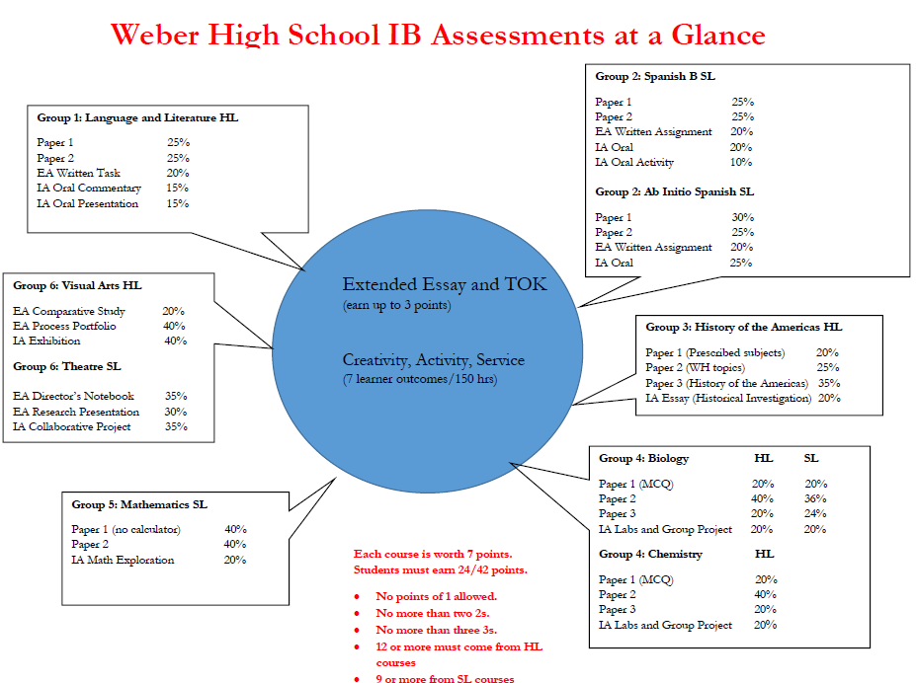
Earning an IB Diploma

Slide 16
AP or IB, that is the question…
AP
IB
“Complete Program”
Interdisciplinary
Internally and externally assessed
Grading scale 1-7
4 is a “passing” score
Specific curriculum requirements across the disciplines
Develops whole student (CAS, EE, TOK)
Classes stand alone
Externally assessed
Grading scale 1-5
3 is a “passing” score
Large selection of classes
Can pick and choose subjects to take by preference
High rigor
College level coursework/ curriculum
Potential college credit
College recognition
of challenge

Slide 17
What should I take in 9th grade to prepare for IB?
IB will fill up most of a student’s schedule in 11th and 12th grade so students should complete their graduation requirements in 9th and 10th grade
We suggest that all 9th graders take the following course:
English
Geography
Earth Science, Physics, or Biology
Math 1
Computer Tech
PE
Spanish (recommended but not required)
Try to take Honors or AP courses if they are offered

Slide 18
What should I take in 10th grade to prepare for IB?
IB will fill up most of a student’s schedule in 11th and 12th grade so students should complete their graduation requirements in 9th and 10th grade
The following courses are required for graduation but NOT covered in IB
CTE Elective
Government
Financial Lit
Health
PE – Fit for Life
In addition to the courses listed above, students still need to take
English 10 Honors
Biology, Chemistry, or Physics*
Secondary Math 2
Spanish
You will also want to take Honors or AP courses in all of your core classes

Slide 19
Weber High Sample Schedule: the average student
 | 9th grade | 10th grade | 11th grade | 12th grade
P1 | English 9 Honors | English 10 Honors | IB Lang and Lit HL | IB Lang and Lit HL
P2 | Geography or AP Geography | US Government/Financial Lit | IB American History HL (AP History) | IB 20th Century History HL
P3 | Spanish 1 | Spanish 2 | IB Ab Initio Spanish SL | IB Ab Initio Spanish SL
P4 | Earth Science or Physics | Chemistry or Biology | IB Biology HL | IB Biology HL (AP Biology)
P5 | Secondary Math 1 | Secondary Math 2 | IB Math SL (Secondary Math 3H) | IB Math SL
P6 | Computer Tech | Theatre 1/ Theatre 2 | IB Theatre SL | CTE Elective
P7 | PE | Fit for Life/Health | The Core – TOK, CAS, EE | The Core - TOK, CAS, EE
P8 |  | Parent Release (elective) | Parent Release (elective) | Parent Release (elective)
Flex |  | Study Hall | Study hall (or elective) | Study hall (or elective)

Slide 20
Weber High Sample Schedule: THE Overachiever
 | 9th grade | 10th grade | 11th grade | 12th grade
P1 | English 9 Honors | English 10 Honors | IB Lang and Lit HL | IB Lang and Lit HL
P2 | AP Geography | Financial Lit/AP Government | IB American History HL (AP History) | IB 20th Century History HL
P3 | Spanish 3 | Spanish 4 | IB Spanish B SL | AP Spanish (elective)
P4 | Physics or Biology | AP Biology | IB Chemistry HL (AP Chemistry) | IB Chemistry HL
P5 | Secondary Math 1 Honors | Secondary Math 2 Honors | IB Math SL (Secondary Math 3H) | IB Math SL
P6 | Computer Tech | Theatre 1/ Theatre 2 | IB Theatre SL | AP Statistics (elective)
P7 | PE | Fit for Life/Health | The Core – TOK, CAS, EE | The Core - TOK, CAS, EE
P8 |  | AP European History (elective) | AP Art History (elective) | CTE Elective
Flex |  | Study Hall | Study Hall (or elective) | Study Hall (or elective)

Slide 21
Weber High Sample Schedule: The ART Student
 | 9th grade | 10th grade | 11th grade | 12th grade
P1 | English 9 Honors | English 10 Honors | IB Lang and Lit HL | IB Lang and Lit HL
P2 | Geography | US Government/Financial Lit | IB American History HL (AP History) | IB 20th Century History HL
P3 |  | Spanish 1 | IB Ab Initio Spanish SL | IB Ab Initio Spanish SL
P4 | Earth Science | Astronomy | IB Biology SL | IB Biology SL
P5 | Secondary Math 1 | Secondary Math 2 | IB Math SL (Secondary Math 3H) | IB Math SL
P6 | Computer Tech | Photo 1/2 | IB Visual Arts HL | IB Visual Arts HL
P7 | PE | Fit for Life/Health | The Core – TOK, CAS, EE | The Core - TOK, CAS, EE
P8 |  | Parent Release (elective) | Parent Release (elective) | Parent Release (elective)
Flex |  | Study Hall | Study hall (or elective) | Study hall (or elective)

Slide 22
College Credits
Weber State – 30 credits with Diploma, where and what type depends on the courses you take and the exam scores.
http://www.weber.edu/Admissions/International_Baccalaureate.html
University of Utah – 30 credits with Diploma, where and what type depends on the courses you take and the exam scores.
http://admissions.utah.edu/apply/special-credit/international-baccalaureate-credit.php
SUU – 30 credits with Diploma, where and what type depends on the courses you take and the exam scores.
https://www.suu.edu/registrar/additional-credit.html
Utah State University – no more than 30 college credits with diploma based on specific exam scores
http://catalog.usu.edu/content.php?catoid=12&navoid=3179
UVU - Students may receive up to 3 credits for scores of 5 to 7 on standard-level exams and 6 credits for scores of 5 to 7 on higher-level exams with a maximum of 30 credits. Will give credit for EE, CAS, and TOK
https://www.uvu.edu/transfer/internationalbaccalaureate.html
SNOW, SLCC, and DIXIE STATE - 30 credits with Diploma, where and what type depends on the courses you take and the exam scores.

Slide 23
QUESTIONS?
Visit our IB website at https://weberhighib.weebly.com/
Contact : Marcia Kloempken
IB Coordinator
makloempken@wsd.net
801-476-3744

